Slide 1
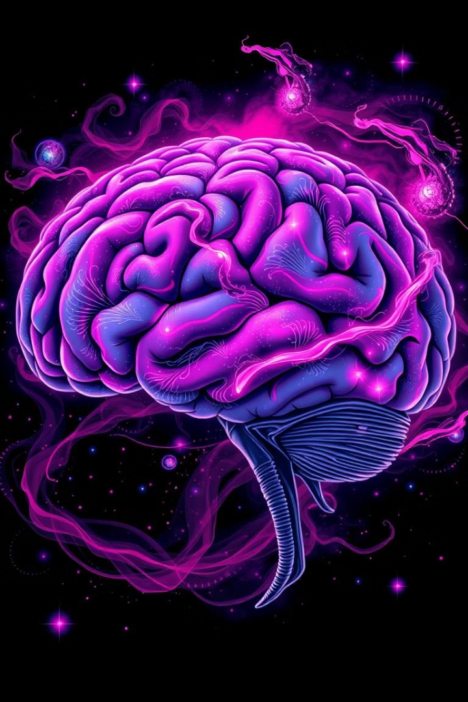

The Amygdala Project: A Neuroscience-Inspired Approach to Emotional Healing
The Amygdala Project aims to unlock the secrets of the amygdala, a key brain structure involved in processing emotions, and use its principles to create a self-aware machine learning model for emotional healing.
by Rishika Rai

Slide 2
Understanding the Amygdala
The Amygdala's Role
Amygdala's Function
The amygdala is a complex structure in the brain's medial temporal lobe that plays a crucial role in processing emotions, particularly fear and anxiety. It receives sensory input and evaluates its significance, triggering physiological and behavioral responses.
The amygdala's activity is linked to emotional learning, memory formation, and social behavior. Understanding its function is key to developing a model for emotional healing.

Slide 3

Project Objectives
1
1. Enhanced Self-Awareness
2
2. Promote Mindfulness
Help users develop a deeper understanding of their emotional responses and behavioral patterns related to ego, attention-seeking, and feelings of shame.
Encourage reflective thinking and mindfulness in decision-making processes, allowing users to approach their experiences with calmness and clarity.
3
3. Facilitate Neuroplasticity
4
4. Avoid Stagnation
Integrate mechanisms that simulate neuroplasticity, enabling the model to adapt and learn from user interactions, promoting personal growth and emotional resilience.
Emphasize continuous learning and adaptation, preventing stagnation in emotional growth, ensuring that users remain engaged and proactive in their self-development journeys.

Slide 4
Neuroplasticity: The Brain's Adaptability
Neuroplasticity: Learning and Growth
Neuroplasticity: Understanding Consciousness
The ability of the brain to reorganize itself by forming new neural connections throughout life, which is essential for learning and recovery from injury. It underlies learning, memory, and the ability to adapt to new experiences or environments.
Conscious experiences can shape neural pathways, influencing our emotional responses, thoughts, and behaviors.

Slide 5




Modeling Ego, Shame, and Attention
Ego
The self-concept, including our identity, self-esteem, and self-importance. The prefrontal cortex plays a crucial role in self-referential processing, decision-making, and regulation of social behavior.
Shame
A complex emotion that arises from the perception of failure, inadequacy, or social disapproval. It often leads to feelings of worthlessness and withdrawal. The limbic system, particularly the amygdala and anterior cingulate cortex, is involved in processing emotions related to shame and social rejection.
Attention
The cognitive process of selectively concentrating on certain information while ignoring other stimuli. It is essential for learning and conscious awareness. The parietal lobes and networks involving the thalamus are crucial for attentional control and sensory integration.

Slide 6

Mathematical Framework: Modeling the Dynamics
Ego Dynamics
Shame Dynamics
= ( − ) + ( − ) dt dE=α(S−E)+β(F−E) Where: E = ego strength S = self-esteem factor (internal) F = feedback from social interactions (external) α and β are positive constants representing sensitivity to self and social feedback.
= ( − ) + ( − ) dt dH=γ(E−H)+δ(R−H) Where: H = shame level R = perceived rejection or failure from social feedback γ and δ are sensitivity parameters.
Attention Dynamics
= ( − ) − ( ) dt dA=ϵ(T−A)−ζ(H) Where: A = attention level T = task demand or relevance H = level of shame (which can detract from attention) ϵ and ζ are constants representing sensitivity to task demand and shame, respectively.

Slide 7



Recurrent Neural Network: Remembering and Relearning
Neuroplasticity
1
The model learns and adapts over time, simulating neuroplasticity.
RNN
2
The model uses a Recurrent Neural Network (RNN) to process information sequentially and retain context over time.
Remembrance
3
The model is designed to "remember" and relearn from previous experiences, simulating the way the brain consolidates and revisits memories.

Slide 8
Quantum Consciousness: A New Frontier
Quantum Consciousness
1
The theoretical idea that our consciousness might be connected to the principles of quantum physics. This suggests that our mental states, like ego, shame, and attention, might exist in a superposition of possibilities.
Quantum-Inspired Models
2
The project aims to develop quantum-inspired models that leverage concepts like superposition, entanglement, and non-locality to explore the nature of consciousness and healing.
Healing
3
The model aims to guide the mind towards healthier states by collapsing the wave function of consciousness.

